Slide 1




YouTube Global Analytics
Performance Insights from 995 Channels Worldwide

Slide 2





EXECUTIVE SUMMARY - KEY METRICS AT A GLANCE
995
9.1M
YouTube Channels
Total Uploads
GLOBAL DATASET COVERAGE
ACROSS ALL ANALYZED CHANNELS
458x
175.6M
Avg Views per Sub
Avg 30-Day Views
ENGAGEMENT EFFICIENCY METRIC
RECENT PERFORMANCE SNAPSHOT

Slide 3






THE RECORD BREAKERS - PEAK PERFORMERS
301,308 Uploads
ABP NEWS — Highest Upload Frequency
Rank #1
Minimum View Rank — Peak Performance Status
175.6M Views
Last 30 Days — Recent Growth Momentum

Slide 4

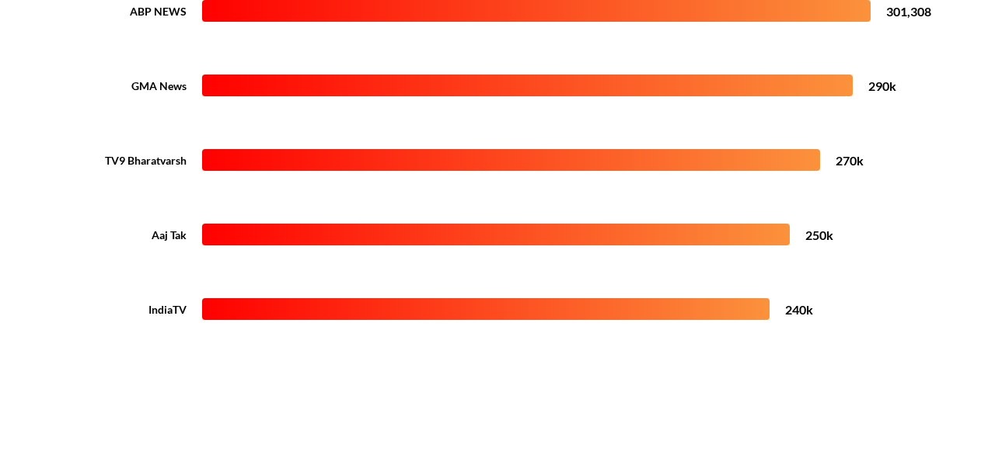
THE ELITE CLUB - 200K+ UPLOAD CHANNELS
INSIGHT: News channels dominate high-volume uploads - strategic content volume is critical for algorithmic presence in news cycles.

Slide 5



CHANNEL TYPE ANALYSIS - PERFORMANCE RADAR
Average Performance
The radar chart illustrates the multi-dimensional performance metrics across channel types. Music and Entertainment sectors exhibit the most balanced high-tier performance across rank and reach.
Primary Performance Sector
Benchmark Threshold

Slide 6

SUBSCRIBER DOMINANCE BY CATEGORY
Market Share of Global YouTube Audience
Music
Entertainment
5.2B Subs
5.2B Subs
People & Blogs
Gaming
2.8B Subs
2.0B Subs
Note: Music and Entertainment command nearly 50% of the top-tier market share combined.

Slide 7





ENGAGEMENT EFFICIENCY: VIEWS PER SUB
"Views Per Subscriber (VPS) measures engagement depth - how many times viewers watch relative to the subscriber base. High VPS = High Intent Audience."
AVERAGE PERFORMER
TOP PERFORMER
TOP ENGAGEMENT CHANNELS
3x Benchmark
01. Ryan's World - 1,571x
02. Vijay Television - 1,441x
03. jbalvinVEVO - 1,320x

Slide 8
PERFORMANCE METRICS BY CHANNEL TYPE
Channel Type | Total Channels | Avg Views/Sub | Engagement Rank
Music | 182 | 682x | Elite
Entertainment | 241 | 590x | High
News | 132 | 421x | Medium
Gaming | 94 | 310x | Medium
Education | 56 | 215x | Niche

Slide 9




KEY INSIGHTS - WHAT THE DATA REVEALS
Market Concentration
Upload Velocity
Music & Entertainment = 40% of Global Market. Massive subscriber concentration requires specific niche strategy for newcomers.
News channels win the algorithmic game with 200K+ uploads. Frequency is the primary driver for "Recent Trend" visibility.
Engagement Variance
Growth Opportunity
A 10x gap exists between top performers and averages. High-intent channels like Ryan's World set the standard for loyalty.
Avg 175M views in last 30 days indicates robust ecosystem growth. Platform expansion is accelerating in emerging markets.

Slide 10








STRATEGIC RECOMMENDATIONS
Analyze VPS Ratio
Upload Cadence
Underserved Niches
Benchmark against leaders. Aim for 500x VPS to ensure your content is resonant with your subscriber base.
News leaders post 100+ times daily. While extreme, consistent daily uploads are the floor for modern growth.
Move beyond Entertainment. Education and Tech show high intent but lower saturation, offering premium CPM potential.

Slide 11








PERFORMANCE HIERARCHY BREAKDOWN
Music
Entertainment
People
Gaming
Comedy
Primary Driver: Reach
Primary Driver: Intent

